Slide 1


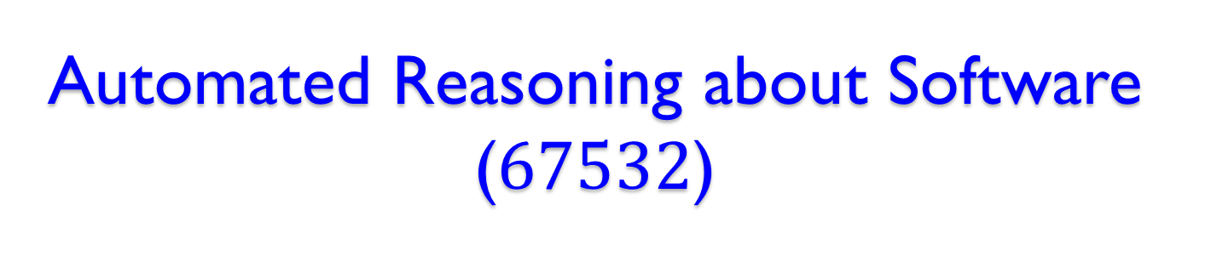
Automated Reasoning about Software ($67532$)
Guy Katz
Lecture $6$: Introduction to SMT, abstract DPLL December $2$^{nd}, $2019$

Slide 2
Acknowledgements
Some of the material presented has been borrowed from slides by David Dill, Isil Dillig, Gera Weiss, Clark Barrett, Alex Aiken, Mooly Sagiv, Sagar Chaki and Ofer Strichman

Slide 3
Overview
We’ve seen the usefulness of Boolean engines: SAT solvers, BDDs
Non-Boolean queries can often be bit-blasted
However, useful abstractions may be lost
Satisfiability Modulo Theories (SMT) lets us determine satisfiability in richer logics

Slide 4
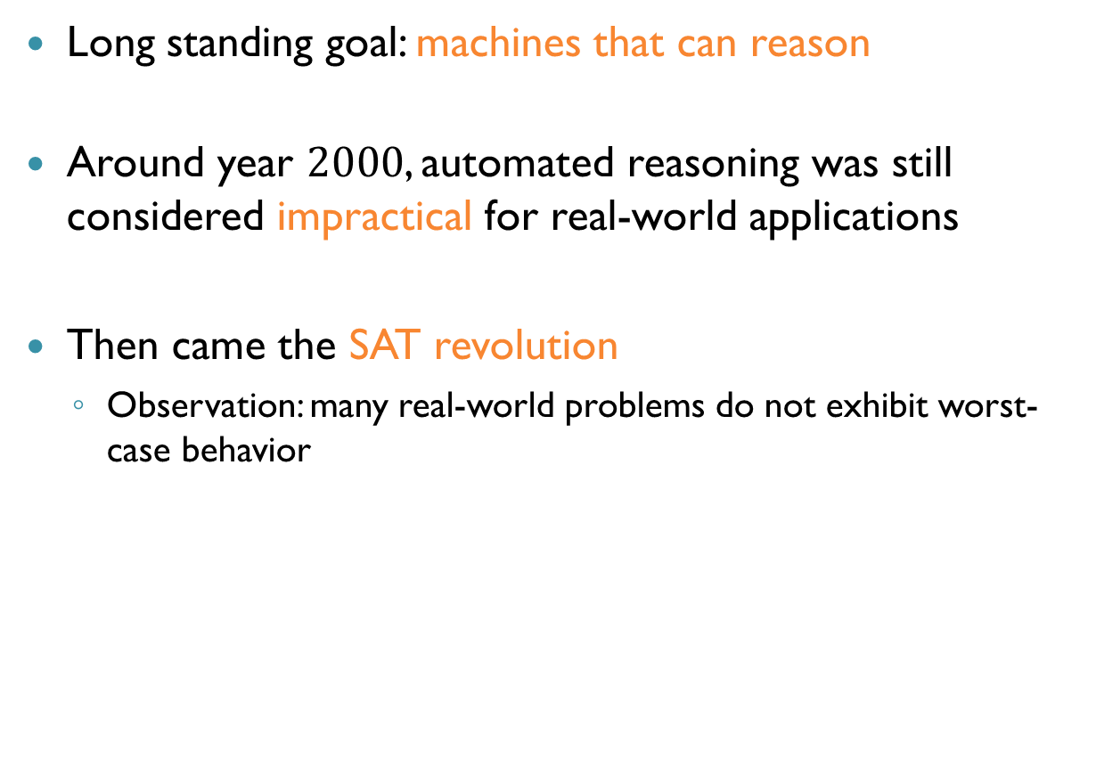
Automated Reasoning
Long standing goal: machines that can reason
Around year $2000$, automated reasoning was still considered impractical for real-world applications
Then came the SAT revolution
Observation: many real-world problems do not exhibit worst-case behavior

Slide 5
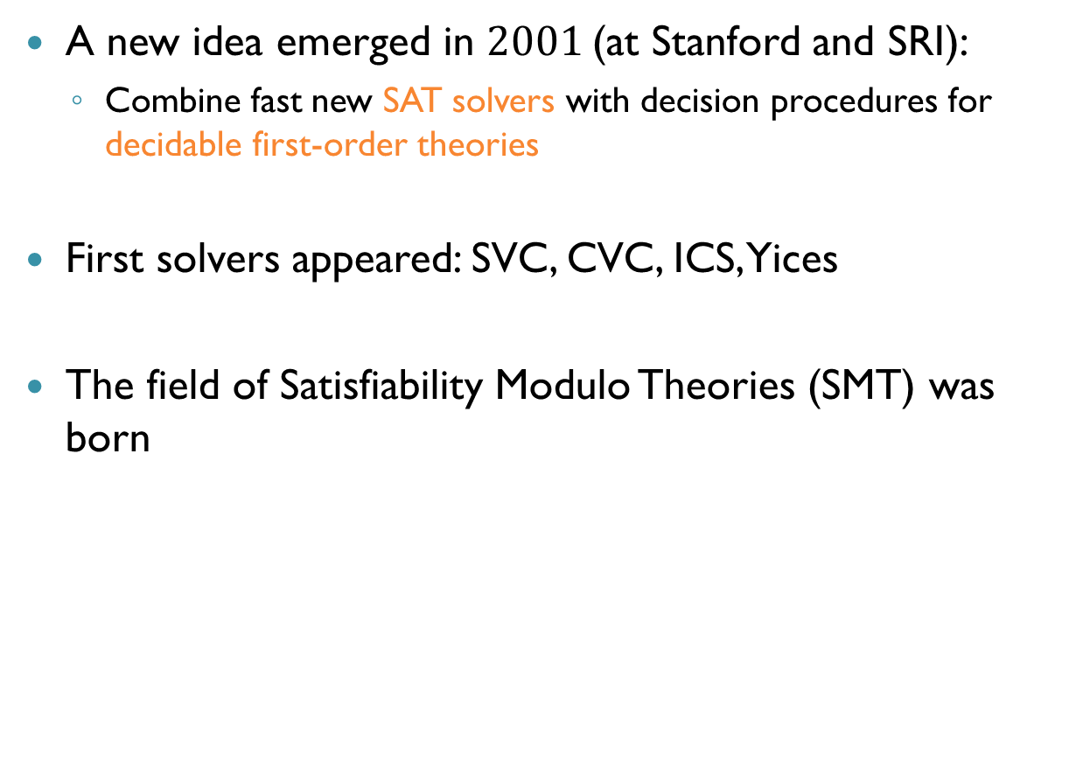
Automated Reasoning (cnt’d)
A new idea emerged in $2001$(at Stanford and SRI):
Combine fast new SAT solvers with decision procedures for decidable first-order theories
First solvers appeared: SVC, CVC, ICS, Yices
The field of Satisfiability Modulo Theories (SMT) was born

Slide 6
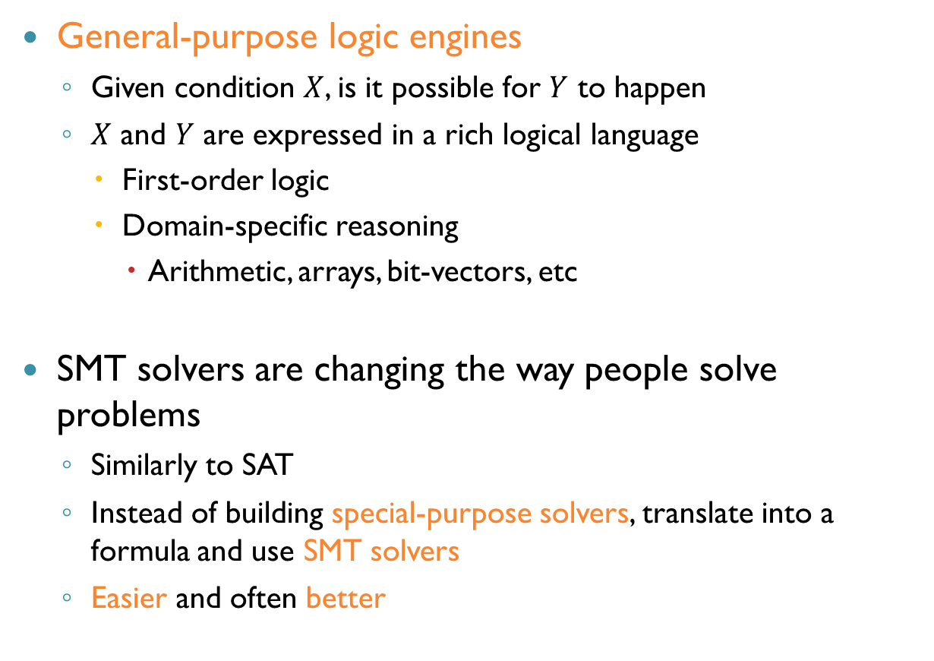
SMT Solvers
General-purpose logic engines
Given condition $X$, is it possible for $Y$ to happen
$X$ and $Y$ are expressed in a rich logical language
First-order logic
Domain-specific reasoning
Arithmetic, arrays, bit-vectors, etc
SMT solvers are changing the way people solve problems
Similarly to SAT
Instead of building special-purpose solvers, translate into a formula and use SMT solvers
Easier and often better

Slide 7
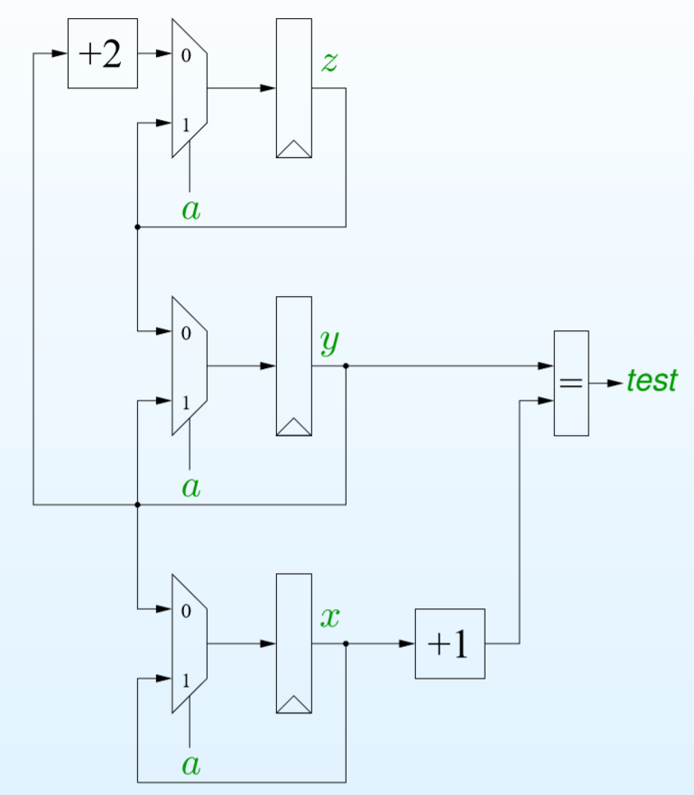

Example
Value of test should always be true
If $a=1$:
$\left(x^{′},y^{′},z^{′}\right)=\left(x,y,z\right)$
$y=x+1$
If $a=0:$
$\left(x^{′},y^{′},z^{′}\right)=\left(y,z,y+2\right)$
$y=x+1$
When does this hold?
$y=x+1, z=x+2$

Slide 8
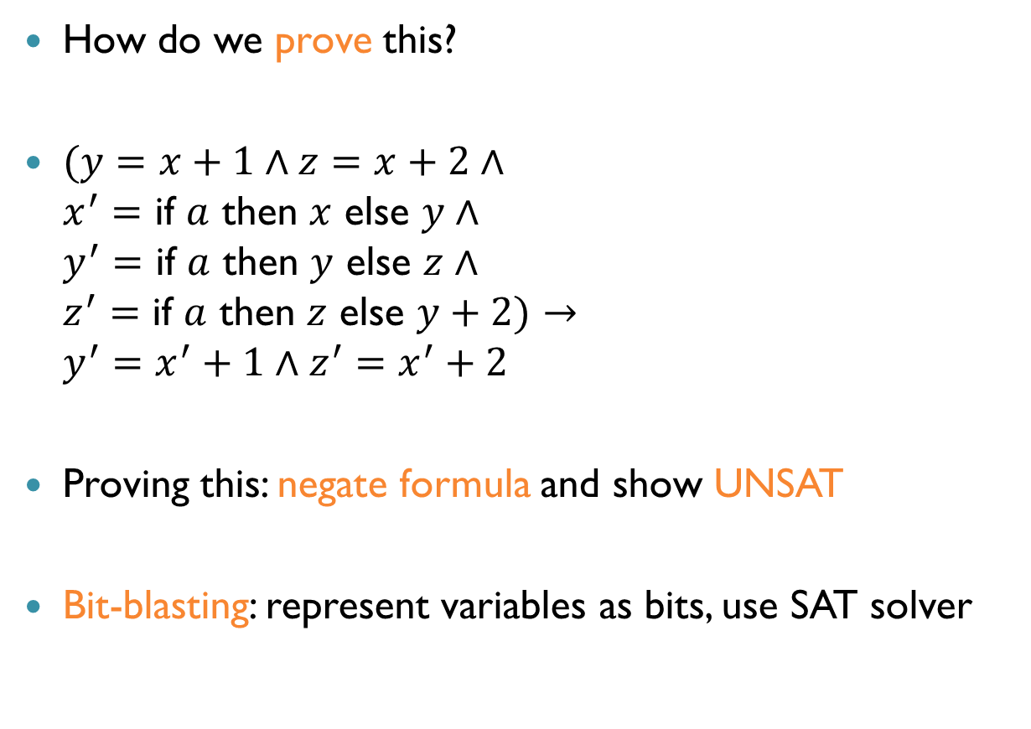
Example (cnt’d)
How do we prove this?
$(y=x+1∧z=x+2∧$ $x^{′}=$ if $a$ then $x$ else $y∧$ $y^{′}=$ if $a$ then $y$ else $z∧$ $z^{′}=$ if $a$ then $z$ else $y+2)→$ $y^{′}=x^{′}+1∧z^{′}=x^{′}+2$
Proving this: negate formula and show UNSAT
Bit-blasting: represent variables as bits, use SAT solver

Slide 9
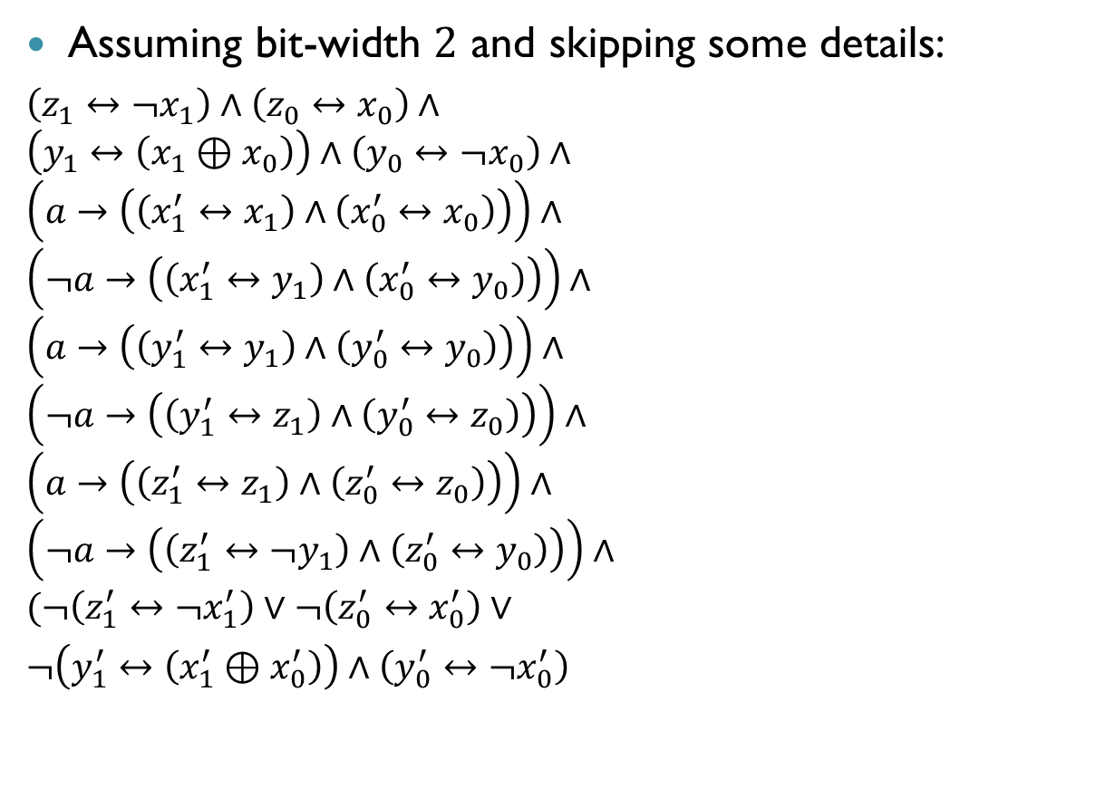
Example (cnt’d)
Assuming bit-width $2$ and skipping some details:
$\left(z_{1}↔¬x_{1}\right)∧\left(z_{0}↔x_{0}\right)∧$ $\left(y_{1}↔\left(x_{1}⊕x_{0}\right)\right)∧\left(y_{0}↔¬x_{0}\right)∧$ $\left(a→\left(\left(x_{1}^{′}↔x_{1}\right)∧\left(x_{0}^{′}↔x_{0}\right)\right)\right)∧$ $\left(¬a→\left(\left(x_{1}^{′}↔y_{1}\right)∧\left(x_{0}^{′}↔y_{0}\right)\right)\right)∧$ $\left(a→\left(\left(y_{1}^{′}↔y_{1}\right)∧\left(y_{0}^{′}↔y_{0}\right)\right)\right)∧$ $\left(¬a→\left(\left(y_{1}^{′}↔z_{1}\right)∧\left(y_{0}^{′}↔z_{0}\right)\right)\right)∧$ $\left(a→\left(\left(z_{1}^{′}↔z_{1}\right)∧\left(z_{0}^{′}↔z_{0}\right)\right)\right)∧$ $\left(¬a→\left(\left(z_{1}^{′}↔¬y_{1}\right)∧\left(z_{0}^{′}↔y_{0}\right)\right)\right)∧$ $(¬\left(z_{1}^{′}↔¬x_{1}^{′}\right)∨¬\left(z_{0}^{′}↔x_{0}^{′}\right)∨$
$¬\left(y_{1}^{′}↔\left(x_{1}^{′}⊕x_{0}^{′}\right)\right)∧\left(y_{0}^{′}↔¬x_{0}^{′}\right)$

Slide 10
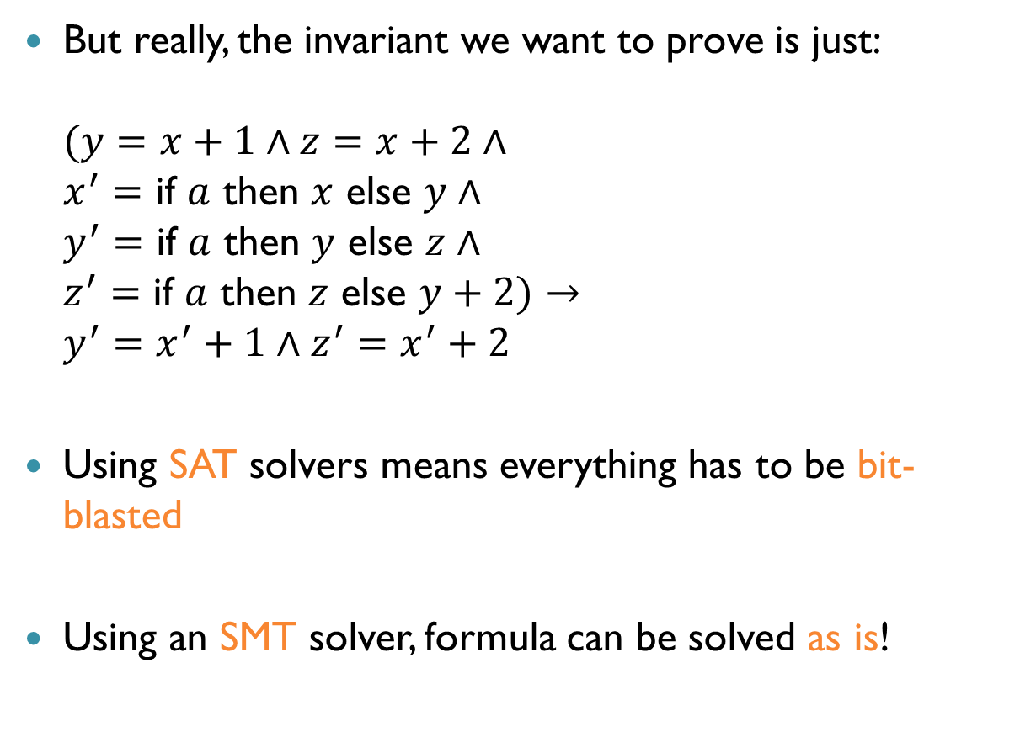
Example (cnt’d)
But really, the invariant we want to prove is just: $(y=x+1∧z=x+2∧$ $x^{′}=$ if $a$ then $x$ else $y∧$ $y^{′}=$ if $a$ then $y$ else $z∧$ $z^{′}=$ if $a$ then $z$ else $y+2)→$ $y^{′}=x^{′}+1∧z^{′}=x^{′}+2$
Using SAT solvers means everything has to be bit-blasted
Using an SMT solver, formula can be solved as is!

Slide 11
The Goal of SMT
The goal of Satisfiability Modulo Theories (SMT) is to create engines than can reason natively at a higher level of abstraction
Benefit from the extra information
But still be as fast and automatic like a Boolean engine!

Slide 12
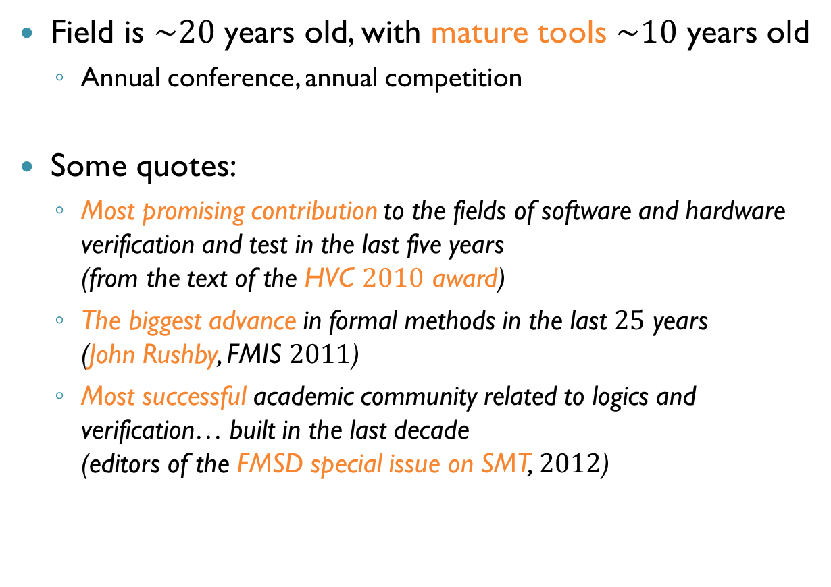
Impact of SMT
Field is $\sim 20$ years old, with mature tools $\sim 10$ years old
Annual conference, annual competition
Some quotes:
Most promising contribution to the fields of software and hardware verification and test in the last five years (from the text of the HVC $2010$ award)
The biggest advance in formal methods in the last $25$ years (John Rushby, FMIS $2011$)
Most successful academic community related to logics and verification… built in the last decade (editors of the FMSD special issue on SMT, $2012$)

Slide 13
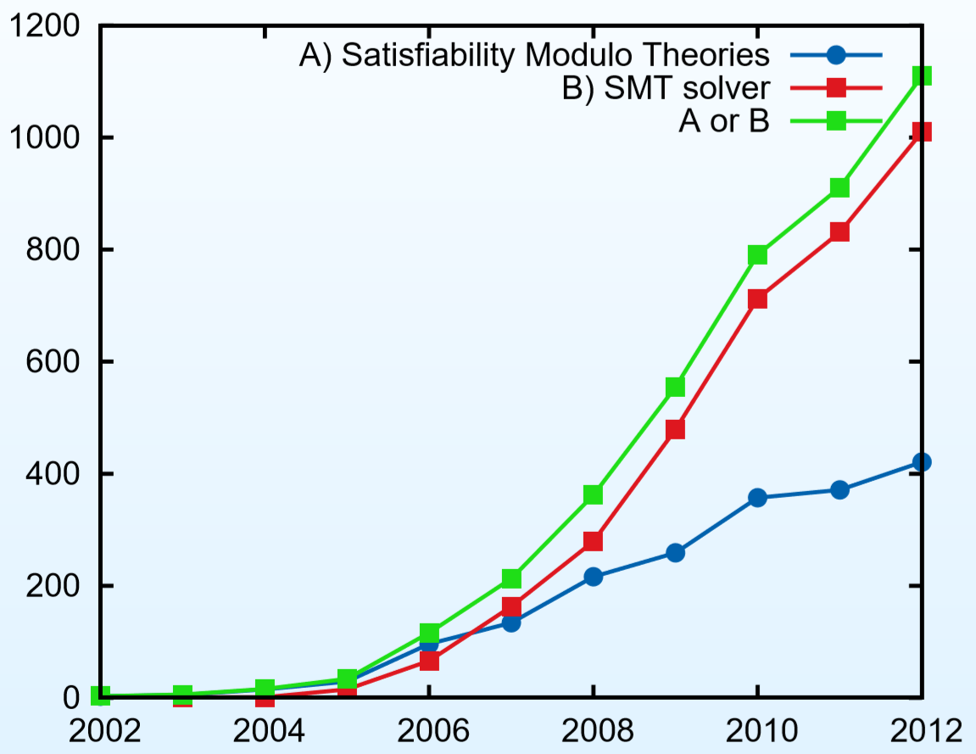
Impact of SMT (cnt’d)
Articles per year by search phrase (from Google Scholar)

Slide 14
SMT Solvers: Language
The language of SAT solvers is propositional logic
The language of SMT solvers is first-order logic (FOL)
Includes the operations of Boolean logic
More complicated expressions are also allowed
A first-order language must specify a signature: the set of allowed constant, function and predicate symbols

Slide 15

SMT Solvers: Language (cnt’d)
Each predicate and function symbol has an associated arity: a natural number indicating how many arguments it takes
Equality: special predicate of arity $2$
Constants can be regarded as functions with arity $0$

Slide 16
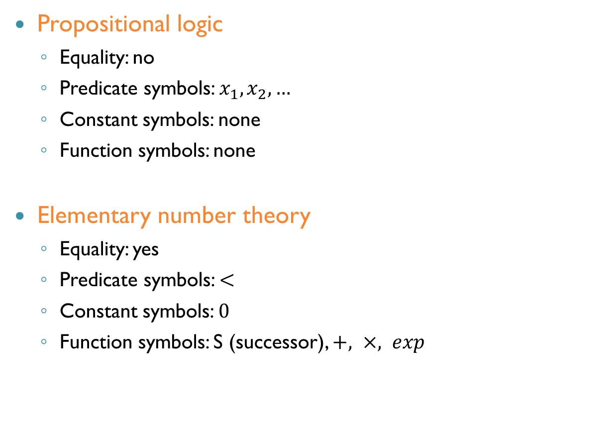
First-Order Languages: Examples
Propositional logic
Equality: no
Predicate symbols: $x_{1},x_{2},…$
Constant symbols: none
Function symbols: none
Elementary number theory
Equality: yes
Predicate symbols: $<$
Constant symbols: $0$
Function symbols: S (successor), $+, ×, exp$

Slide 17
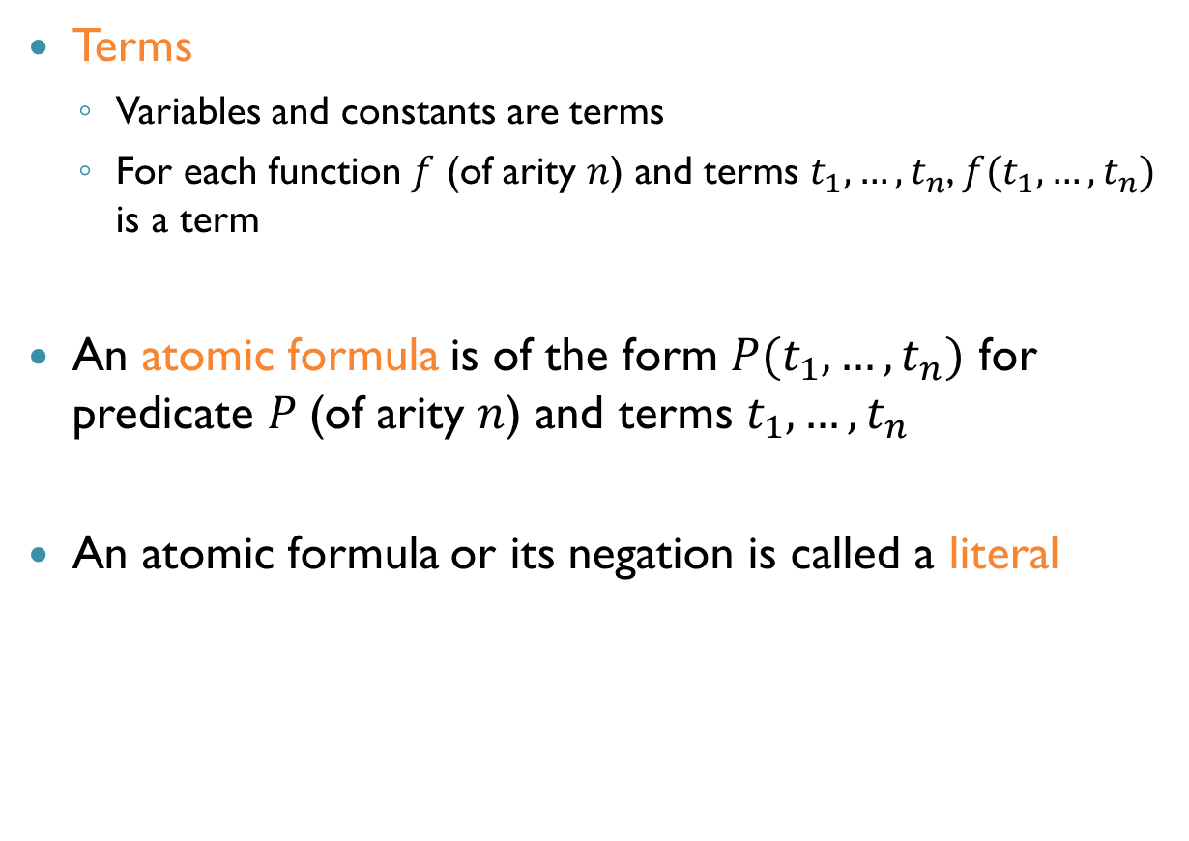
First-Order Logic: Syntax
Terms
Variables and constants are terms
For each function $f$ (of arity $n$) and terms $t_{1},…,t_{n}$, $f(t_{1},…, t_{n})$ is a term
An atomic formula is of the form $P(t_{1},…,t_{n})$ for predicate $P$(of arity $n$) and terms $t_{1},…, t_{n}$
An atomic formula or its negation is called a literal
רגע של עברית: שם עצם, נוסחה אטומית, ליטרל

Slide 18

First-Order Logic: Syntax (cnt’d)
Formulas are built from literals using Boolean operators and quantification
If $α$ is a formula, then for every variable $x$,
$∀xα$ is a formula
$∃xα$ is a formula

Slide 19
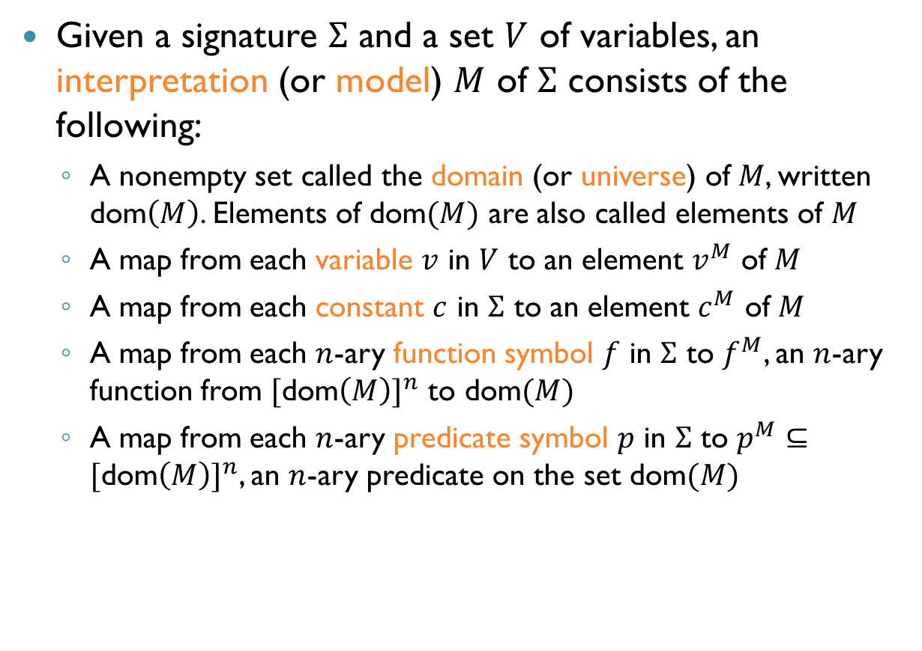
First-Order Logic: Semantics
Given a signature $Σ$ and a set $V$ of variables, an interpretation (or model) $M$ of $Σ$ consists of the following:
A nonempty set called the domain (or universe) of $M$, written dom$\left(M\right)$. Elements of dom$(M)$ are also called elements of $M$
A map from each variable $v$ in $V$ to an element $v^{M}$ of $M$
A map from each constant $c$ in $Σ$ to an element $c^{M}$ of $M$
A map from each $n$-ary function symbol $f$ in $Σ$ to $f^{M}$, an $n$-ary function from $[$dom$\left(M\right)]^{n}$ to dom$(M)$
A map from each $n$-ary predicate symbol $p$ in $Σ$ to $p^{M}⊆[\text{dom}\left(M\right)]^{n}$, an $n$-ary predicate on the set dom$(M)$

Slide 20
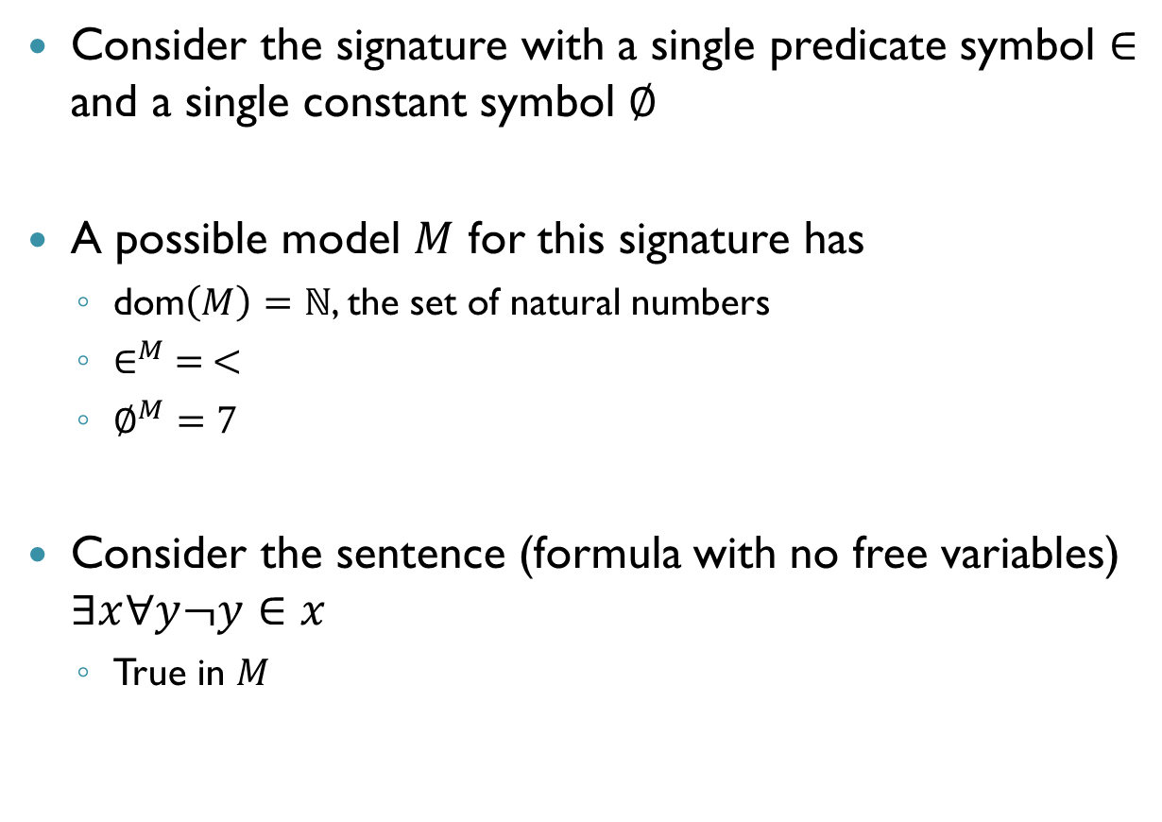
Example
Consider the signature with a single predicate symbol $∈$ and a single constant symbol $∅$
A possible model $M$ for this signature has
dom$\left(M\right)=ℕ$, the set of natural numbers
$∈^{M} = <$
$∅^{M}=$ $7$
Consider the sentence (formula with no free variables) $∃x∀y¬y∈x$
True in $M$
רגע של עברית: פסוק

Slide 21

First-Order Logic: Semantics
Given a formula $φ$, we say that $M$ satisfies $φ$ and write $M⊨φ$ if $φ$ is true in the model $M$
A formula $φ$ is valid, written $⊨φ$, if $M⊨φ$ for every $M$

Slide 22
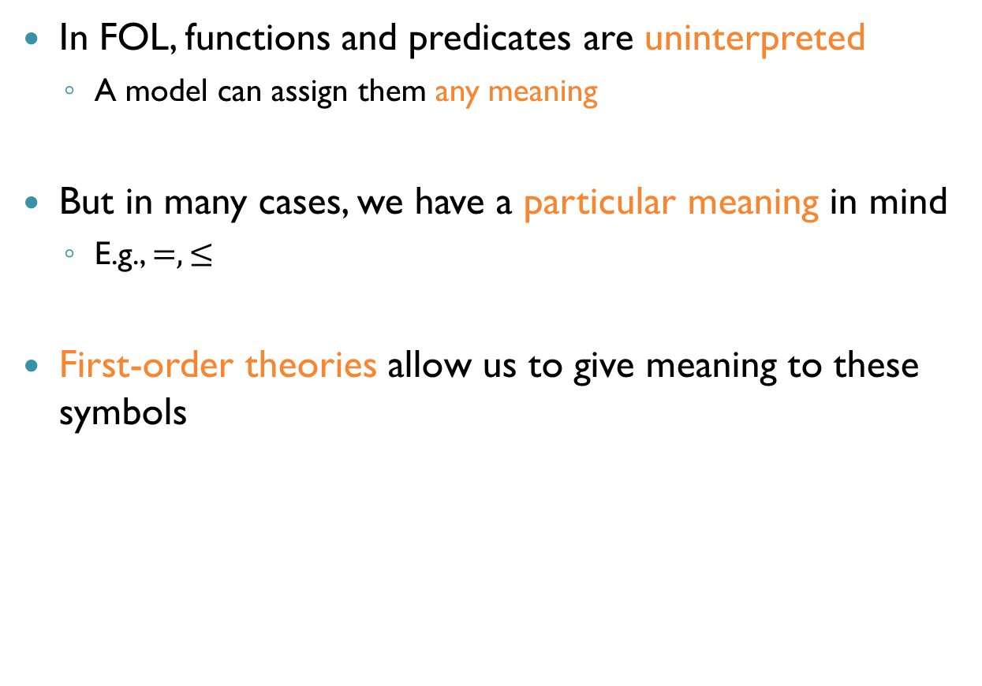
First-Order Theories
In FOL, functions and predicates are uninterpreted
A model can assign them any meaning
But in many cases, we have a particular meaning in mind
E.g., $=, ≤$
First-order theories allow us to give meaning to these symbols

Slide 23
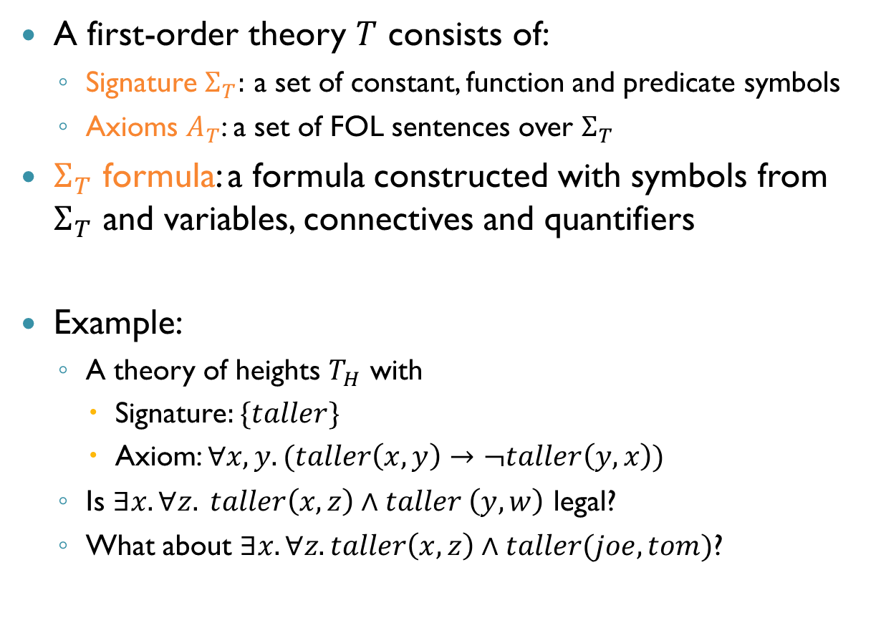
First-Order Theories (cnt’d)
A first-order theory $T$ consists of:
Signature $Σ_{T}:$ a set of constant, function and predicate symbols
Axioms $A_{T}$: a set of FOL sentences over $Σ_{T}$
$Σ_{T}$ formula: a formula constructed with symbols from $Σ_{T}$ and variables, connectives and quantifiers
Example:
A theory of heights $T_{H}$ with
Signature$:\{taller\}$
Axiom: $∀x,y. (taller\left(x,y\right)→¬taller\left(y,x\right))$
Is $∃x.∀z. taller\left(x,z\right)∧taller \left(y,w\right)$ legal?
What about $∃x. ∀z. taller\left(x,z\right)∧taller(joe, tom)$?
Yes
No

Slide 24
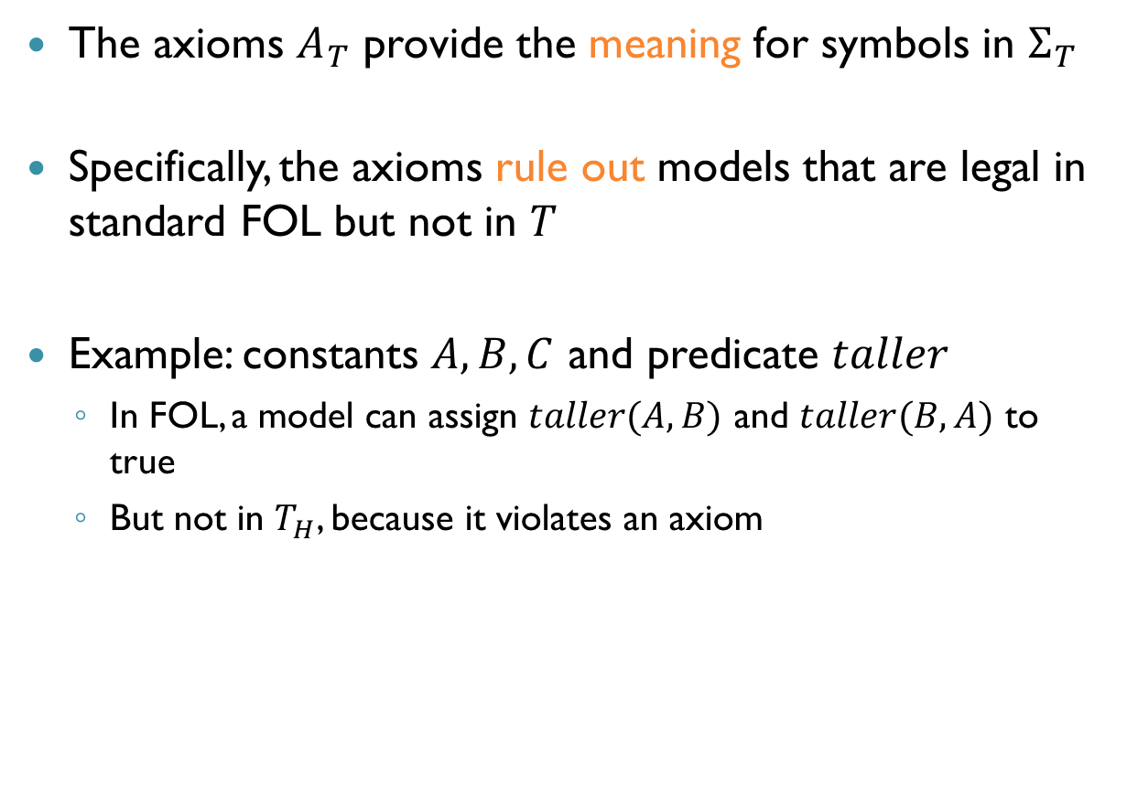
First-Order Theories (cnt’d)
The axioms $A_{T}$ provide the meaning for symbols in $Σ_{T}$
Specifically, the axioms rule out models that are legal in standard FOL but not in $T$
Example: constants $A,B,C$ and predicate $taller$
In FOL, a model can assign $taller(A,B)$ and $taller(B,A)$ to true
But not in $T_{H}$, because it violates an axiom

Slide 25
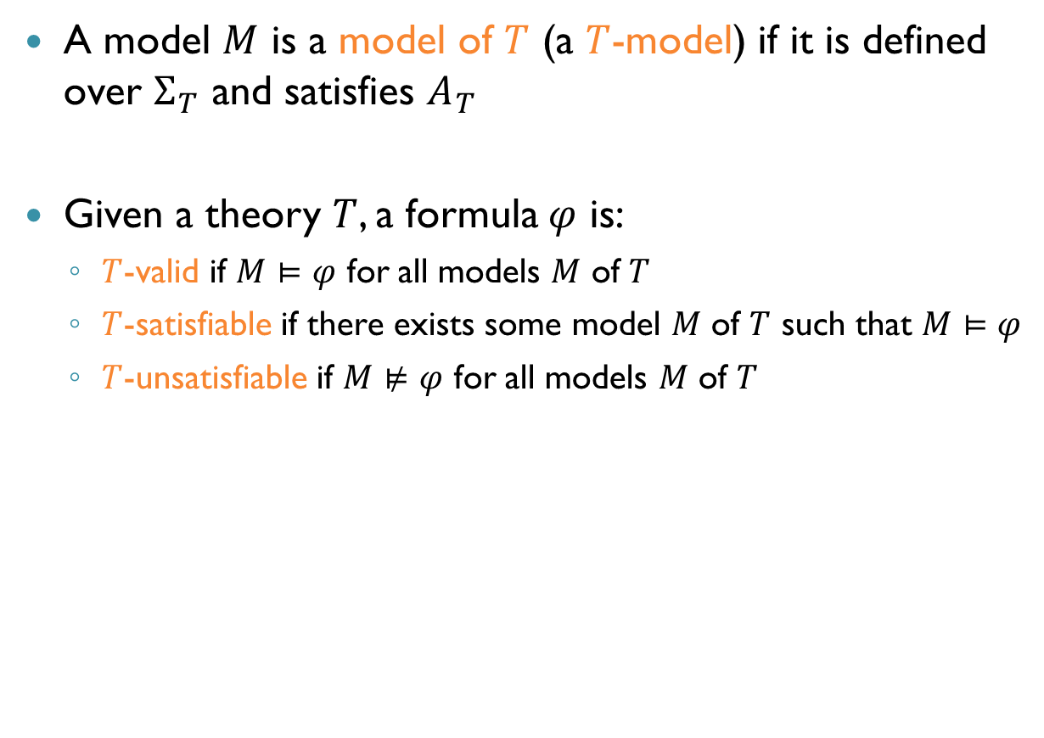
First-Order Theories: Semantics
A model $M$ is a model of $T$ (a $T$-model) if it is defined over $Σ_{T}$ and satisfies $A_{T}$
Given a theory $T$, a formula $φ$ is:
$T$-valid if $M⊨φ$ for all models $M$ of $T$
$T$-satisfiable if there exists some model $M$ of $T$ such that $M⊨φ$
$T$-unsatisfiable if $M⊭φ$ for all models $M$ of $T$

Slide 26
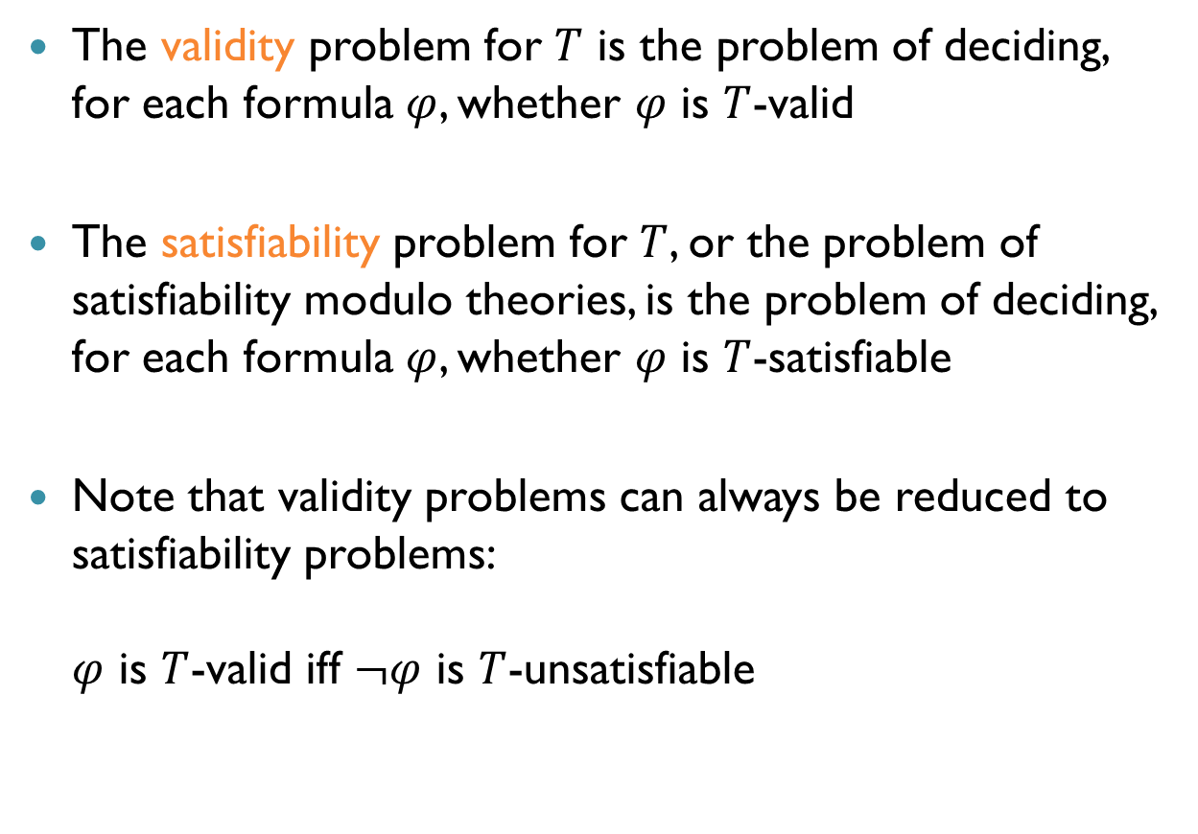
The SMT Problem
The validity problem for $T$ is the problem of deciding, for each formula $φ$, whether $φ$ is $T$-valid
The satisfiability problem for $T$, or the problem of satisfiability modulo theories, is the problem of deciding, for each formula $φ$, whether $φ$ is $T$-satisfiable
Note that validity problems can always be reduced to satisfiability problems: $φ$ is $T$-valid iff $¬φ$ is $T$-unsatisfiable

Slide 27
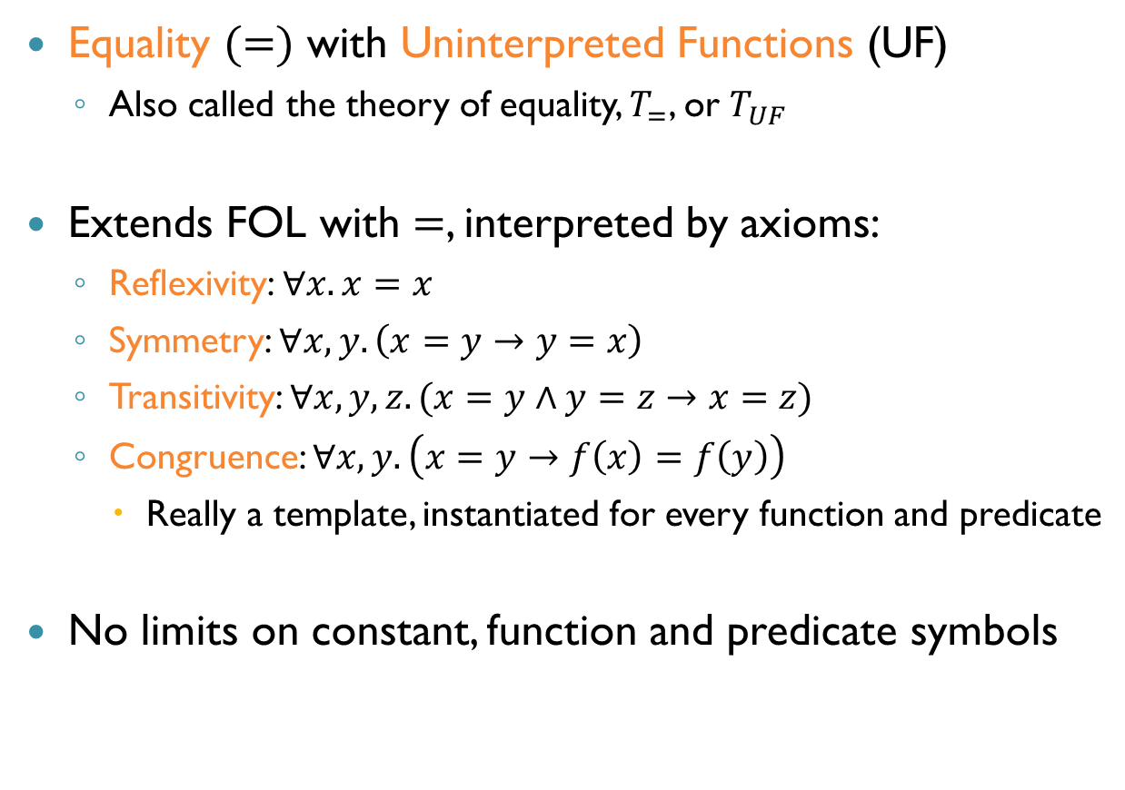
Theories of Interest: UF
Equality $(=)$ with Uninterpreted Functions (UF)
Also called the theory of equality, $T_{=}$, or $T_{UF}$
Extends FOL with $=$, interpreted by axioms:
Reflexivity: $∀x. x=x$
Symmetry: $∀x,y. \left(x=y→y=x\right)$
Transitivity: $∀x,y,z. (x=y∧y=z→x=z)$
Congruence: $∀x,y. \left(x=y→f\left(x\right)=f\left(y\right)\right)$
Really a template, instantiated for every function and predicate
No limits on constant, function and predicate symbols

Slide 28
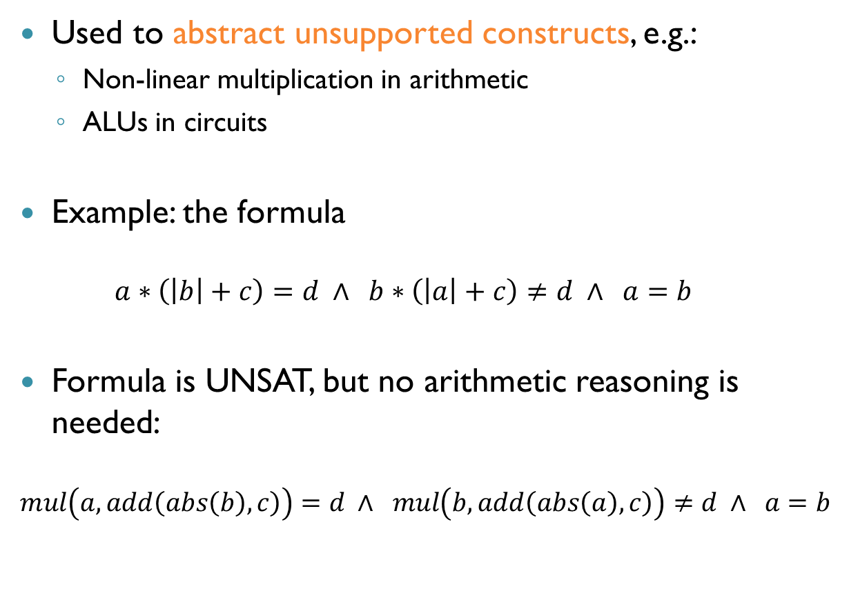
Theories of Interest: UF (cnt’d)
Used to abstract unsupported constructs, e.g.:
Non-linear multiplication in arithmetic
ALUs in circuits
Example: the formula $a∗\left(\left|b\right|+c\right)=d ∧ b∗\left(\left|a\right|+c\right)≠d ∧ a=b$
Formula is UNSAT, but no arithmetic reasoning is needed:
$$mul\left(a,add\left(abs\left(b\right),c\right)\right)=d ∧ mul\left(b,add\left(abs\left(a\right),c\right)\right)≠d ∧ a=b$$

Slide 29
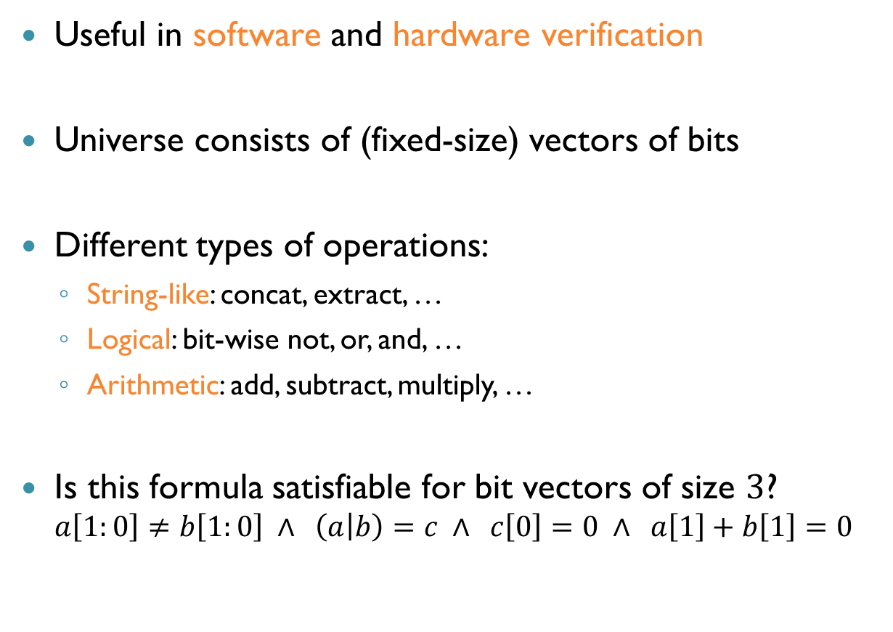
Theories of Interest: Bit Vectors
Useful in software and hardware verification
Universe consists of (fixed-size) vectors of bits
Different types of operations:
String-like: concat, extract, …
Logical: bit-wise not, or, and, …
Arithmetic: add, subtract, multiply, …
Is this formula satisfiable for bit vectors of size $3$? $a\left[1:0\right]≠b\left[1:0\right] ∧ \left(a | b\right)=c ∧ c\left[0\right]=0 ∧ a\left[1\right]+b\left[1\right]=0$

Slide 30
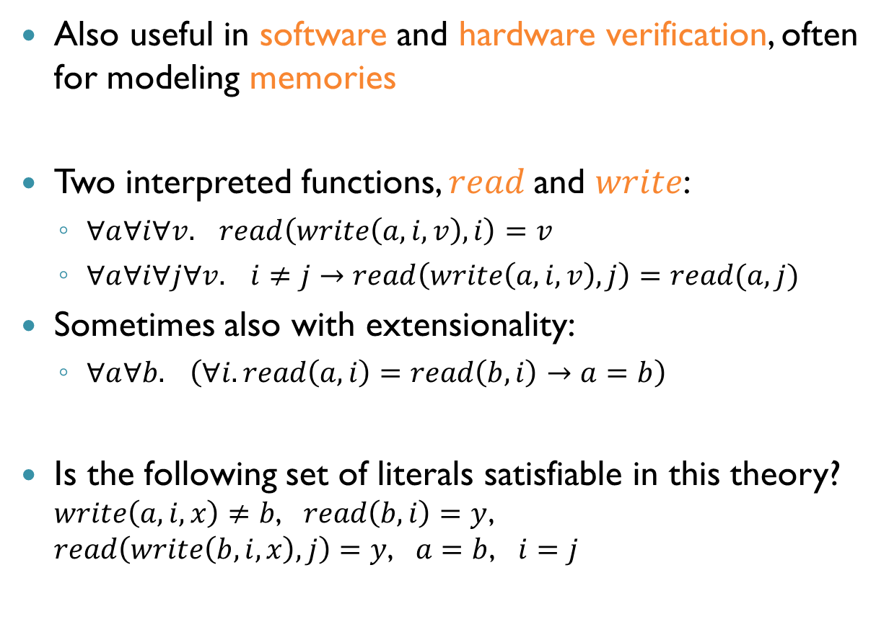
Theories of Interest: Arrays
Also useful in software and hardware verification, often for modeling memories
Two interpreted functions, $read$and $write$:
$∀a∀i∀v. read\left(write\left(a,i,v\right),i\right)=v$
$∀a∀i∀j∀v. i≠j→read\left(write\left(a,i,v\right),j\right)=read(a,j)$
Sometimes also with extensionality:
$∀a∀b. \left(∀i.read\left(a,i\right)=read\left(b,i\right)→a=b\right)$
Is the following set of literals satisfiable in this theory? $write\left(a,i,x\right)≠b$, $read\left(b,i\right)=y$, $read\left(write\left(b,i,x\right),j\right)=y$, $a=b$, $i=j$

Slide 31
Theories of Interest
Other theories of interest:
Arithmetic
Sets
Strings
and others

Slide 32
The Eager and Lazy Approaches
Eager SMT solving: encode an SMT problem into SAT
For some theories, this works well
Notable systems: UCLID
However, we focus on the lazy approach
A technique for combining SAT reasoning with theory reasoning
The lazy approach is the basis for most modern solvers
Notable systems: Z3, CVC4, Boolector, Yices, MathSAT

Slide 33
The Lazy Approach: Principles
Abstract the input formula into a propositional one
Feed it to a (DPLL-based) SAT solver
Use a theory decision procedure to refine the formula and guide the SAT solver

Slide 34
The DPLL(T) Architecture
Arithmetic
Uninterpreted Functions
Sets
SAT Solver
Bitvectors
Arrays

Slide 35

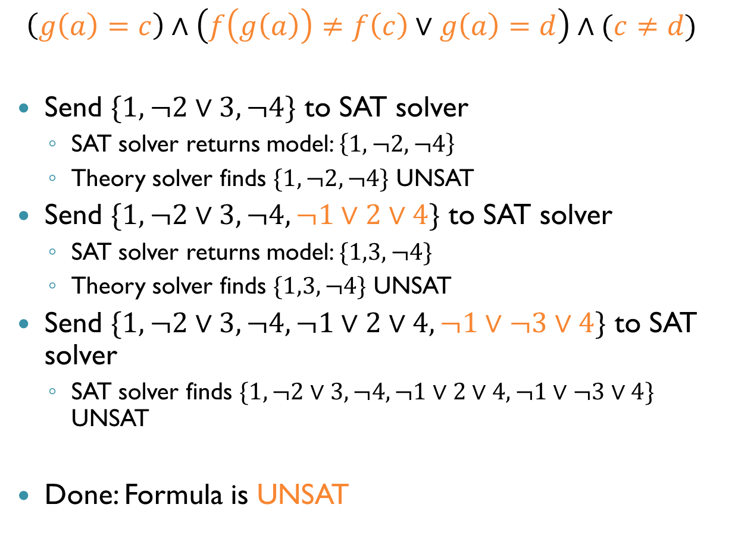



Example: Uninterpreted Functions
$$\left(g\left(a\right)=c\right)∧\left(f\left(g\left(a\right)\right)≠f\left(c\right)∨g\left(a\right)=d\right)∧(c≠d)$$
Send $\{1,¬2∨3,¬4\}$ to SAT solver
SAT solver returns model: $\left\{1,¬2,¬4\right\}$
Theory solver finds $\{1,¬2,¬4\}$ UNSAT
Send $\{1,¬2∨3,¬4,¬1∨2∨4\}$ to SAT solver
SAT solver returns model: $\{1,3,¬4\}$
Theory solver finds $\{1,3,¬4\}$ UNSAT
Send $\{1,¬2∨3,¬4,¬1∨2∨4,¬1∨¬3∨4\}$ to SAT solver
SAT solver finds $\{1,¬2∨3,¬4,¬1∨2∨4,¬1∨¬3∨4\}$ UNSAT
Done: Formula is UNSAT
$$x_{1}$$
$$¬x_{2}$$
$$x_{3}$$
$$¬x_{4}$$

Slide 36
SMT: Main Challenges
How to solve conjunctions of literals in a theory?
Use theory solvers
How to combine solvers for multiple theories
The Nelson-Oppen method
How to combine a theory solver and a SAT solver
The DPLL(T) framework

Slide 37
Abstract DPLL
Before we can talk about DPLL(T), we need to revisit DPLL
Previously: DPLL as an algorithm
Now: DPLL as a set of rules
This is often a convenient way to think about algorithms
A set of “legal” moves
Possibly with a strategy for choosing the next move

Slide 38
Abstract Frameworks: Advantages
Skip over implementation details
Reason formally about solvers for SAT and SMT
Separately describe strategies, prove their correctness
High-level comparison of systems

Slide 39
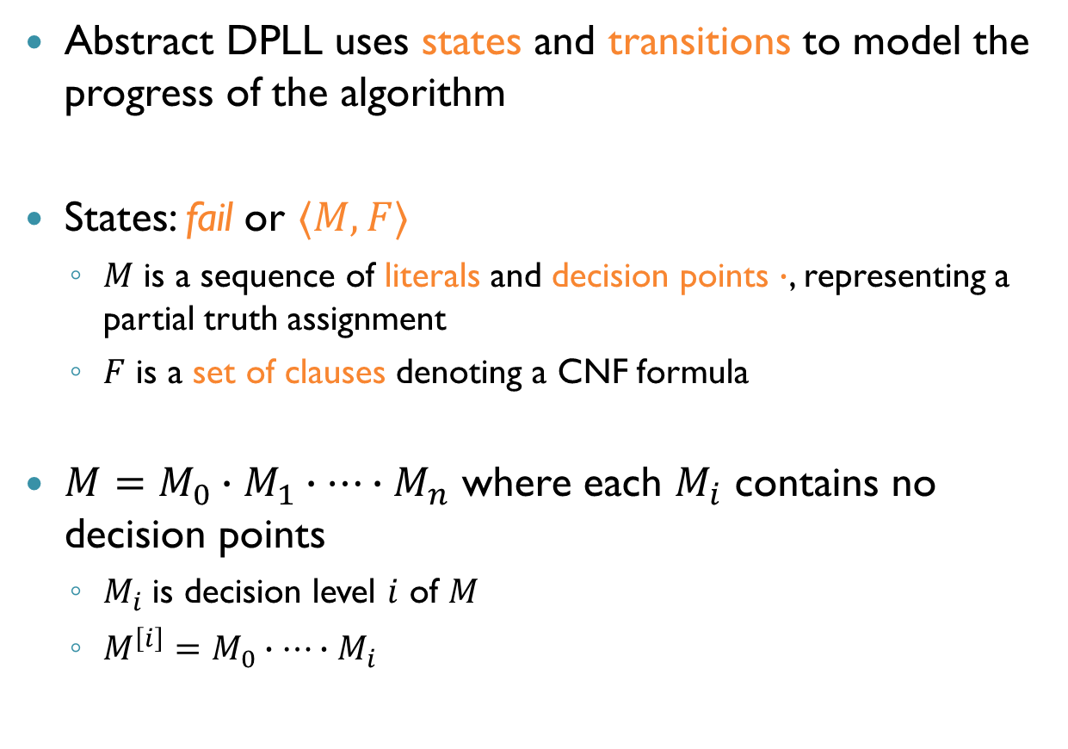
Abstract DPLL (cnt’d)
Abstract DPLL uses states and transitions to model the progress of the algorithm
States: fail or $〈M,F〉$
$M$ is a sequence of literals and decision points $∙$, representing a partial truth assignment
$F$ is a set of clauses denoting a CNF formula
$M=M_{0}∙M_{1}∙…∙M_{n}$ where each $M_{i}$ contains no decision points
$M_{i}$ is decision level $i$ of $M$
$M^{\left[i\right]}=M_{0}∙⋯∙M_{i}$

Slide 40
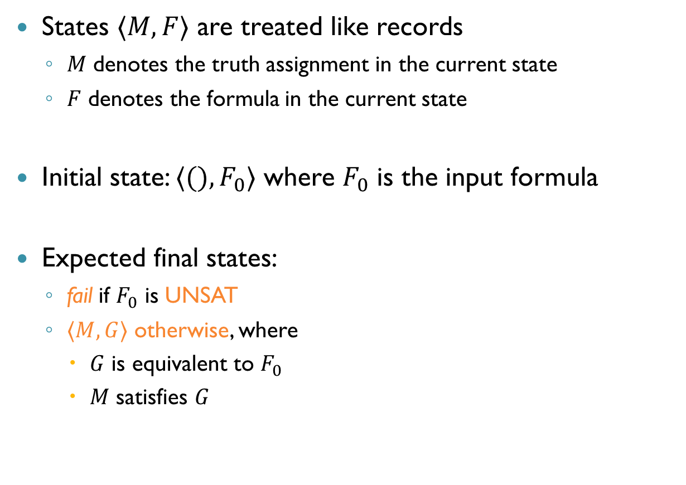
Abstract DPLL (cnt’d)
States $〈M,F〉$ are treated like records
$M$ denotes the truth assignment in the current state
$F$ denotes the formula in the current state
Initial state: $〈(), F_{0}〉$ where $F_{0}$ is the input formula
Expected final states:
fail if $F_{0}$ is UNSAT
$〈M,G〉$ otherwise, where
$G$ is equivalent to $F_{0}$
$M$ satisfies $G$

Slide 41
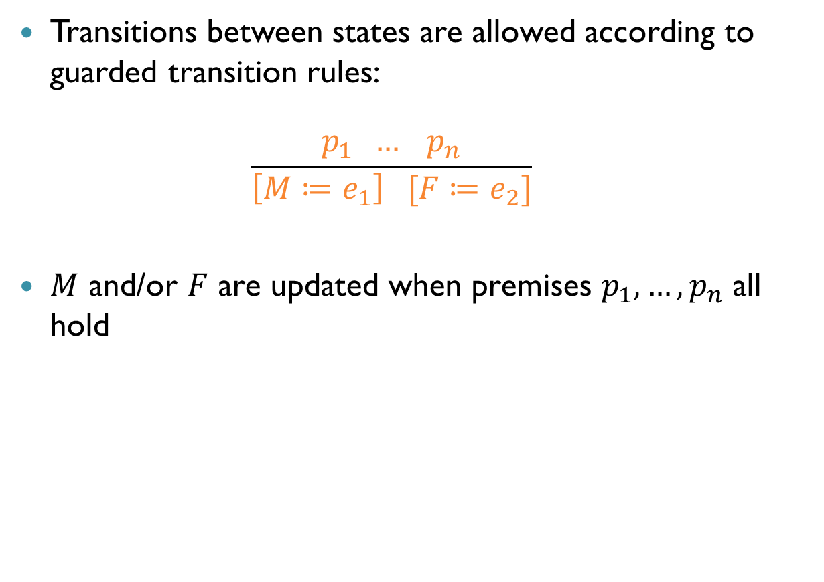
Abstract DPLL (cnt’d)
Transitions between states are allowed according to guarded transition rules: $\frac{p_{1} … p_{n}}{\left[M≔e_{1}\right] [F≔e_{2}]}$
$M$ and/or $F$ are updated when premises $p_{1},…,p_{n}$ all hold

Slide 42
Recap: DPLL
What are the main operations of DPLL?
Decide: assign a non-assigned literal
Propagate: use BCP to assign literals
Backtrack: undo previous decision when UNSAT is reached
We focus on chronological backtracking for now
Fail: return UNSAT

Slide 43
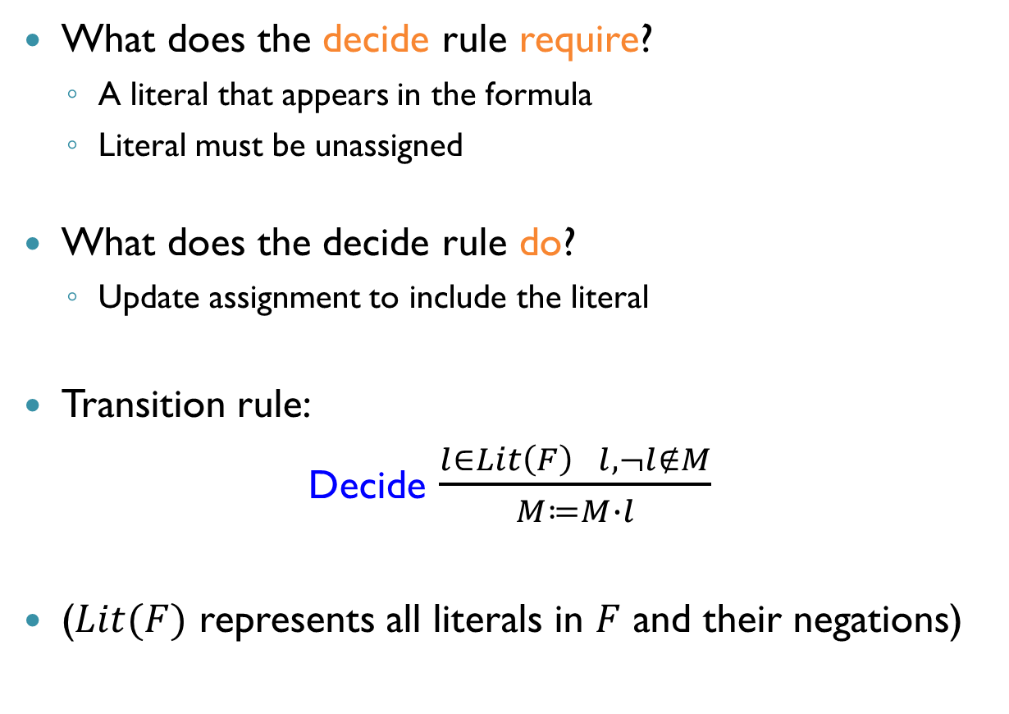
DPLL Transition Rules: Decide
What does the decide rule require?
A literal that appears in the formula
Literal must be unassigned
What does the decide rule do?
Update assignment to include the literal
Transition rule:
Decide $\frac{l∈Lit\left(F\right) l,¬l∉M}{M≔M∙l}$
($Lit(F)$ represents all literals in $F$ and their negations)

Slide 44
DPLL Transition Rules: Propagate
The propagate rule mimics BCP
What does the propagate rule require?
A clause in the formula
All literals but one assigned to false
Last literal unassigned
What does the propagate rule do?
Update assignment to include the variable

Slide 45

DPLL Transition Rules: Propagate
Transition rule:
Propagate $\frac{l_{1}∨…∨l_{n}∨l∈F ¬l_{1},…, ¬l_{n}∈M l,¬l∉M}{M≔Ml}$
(Clauses are treated modulo commutativity)

Slide 46
DPLL Transition Rules: Backtrack
What does the backtrack rule require?
A clause
All literals assigned to false
Assignment must include a decision point
What does the backtrack rule do?
Pop last decision point and everything that followed
Update assignment to include negation of decision literal

Slide 47

DPLL Transition Rules: Backtrack
Transition rule:
Backtrack $\frac{l_{1}∨…∨l_{n}∈F ¬l_{1},…, ¬l_{n}∈M M=M^{′}∙lN ∙∉N}{M≔M^{′}¬l}$
Note that Backtrack enforces chronological backtracking

Slide 48
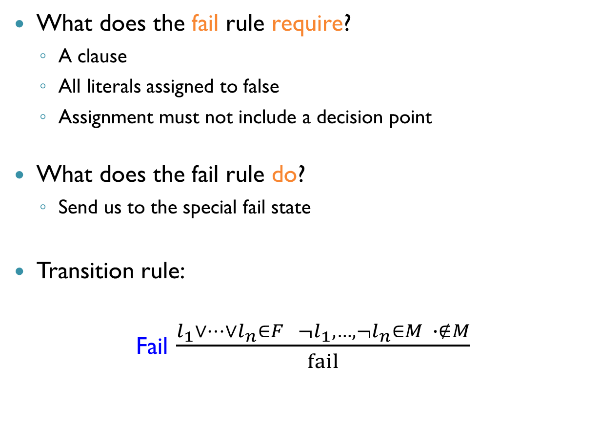
DPLL Transition Rules: Fail
What does the fail rule require?
A clause
All literals assigned to false
Assignment must not include a decision point
What does the fail rule do?
Send us to the special fail state
Transition rule:
Fail $\frac{l_{1}∨…∨l_{n}∈F ¬l_{1},…, ¬l_{n}∈M ∙∉M}{fail}$

Slide 49
Summary
SMT is an extension of SAT to richer logics
Seeks to maintain the speed and automation of SAT
Many interesting problems and applications
The lazy approach:
SAT solver solves abstract propositional formula
Theory solver helps and guides the search
Highly modular!
Saw the rules of Abstract DPLL
Coming up next: Abstract DPLL(T) and Theory Solvers

